Slide 1


Analog Electronics Fundamentals 103
-Zener Diodes
-Voltage Regulators
-Bipolar Junction Transistors (BJTs)
-555 Timer
-Demonstration: Variable Bench PowerSupply/Zener
-Lab1: Basic Transistor Amplifier
-Lab2: 555 One Shot (Monostable Configuration)
-Lab3: 555 LED Flasher (Astable Multivibrator)
-Lab4: 555 Timer Buzzer
-Final Project: Create Variable power supply 3v ~ 5v with 9v input

Slide 2
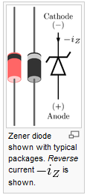
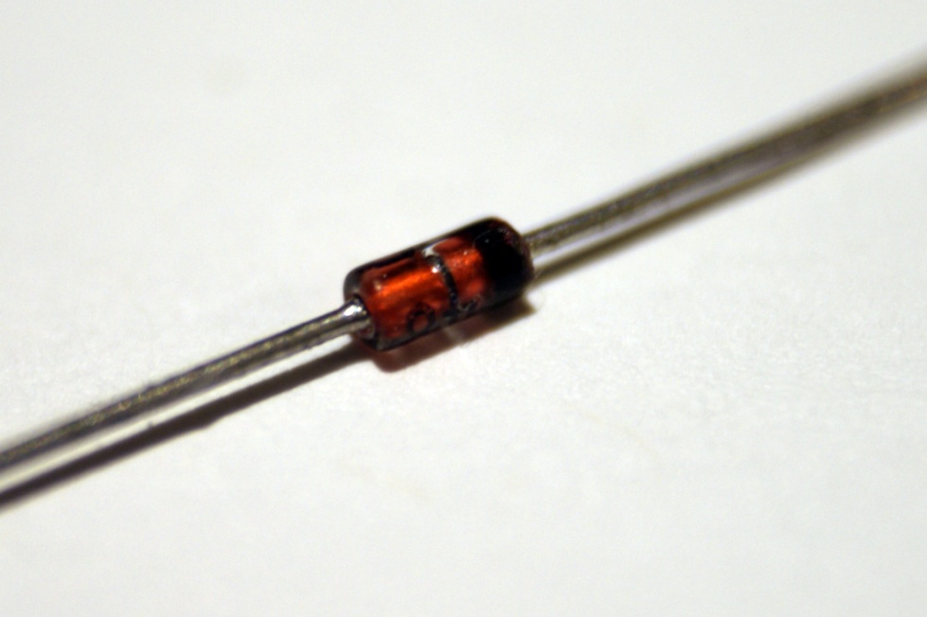
1 Zener Diodes
A zener diode is a special kind of diode which allows current to flow in the forward direction in the same manner as an ideal diode, but will also permit it to flow in the reverse direction when the voltage is above a certain value known as the breakdown voltage, "zener knee voltage" or "zener voltage.“
The zener diode used in reverse bias is ideal for applications such as the generation of a reference voltage (e.g. for an amplifier stage), or as a voltage stabilizer for low-current applications. (Poor man’s voltage regulation)
**Excerpts taken from: Wikipedia

Slide 3
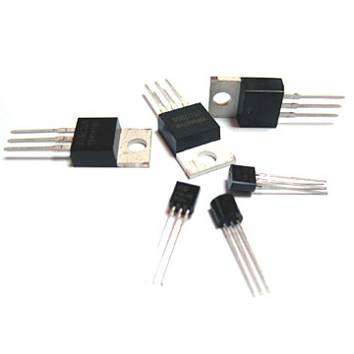
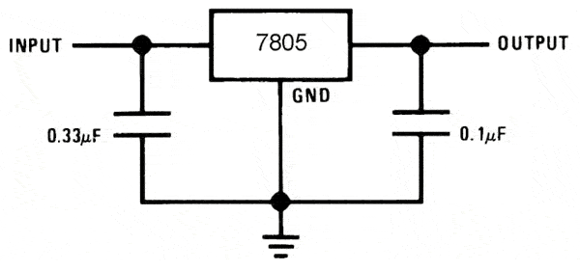
2 Voltage Regulators
A voltage regulator is an electrical regulator designed to automatically maintain a constant voltage level.
Depending on the design, it may be used to regulate one or more AC or DC voltages.
Typical Voltage regulators, like the LM7805 are used to regulate to a pre-determined voltage (LM7805 would be a 5v regulator)
Variable voltage regulators are available, such as the LM317, where voltage can be adjusted from a low to high range.
All Voltage Regulator Datasheets have example circuit schematics for basic and advanced usage.
**Excerpts taken from: Wikipedia

Slide 4
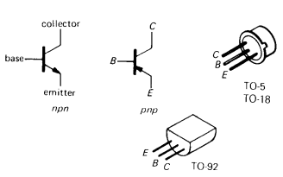
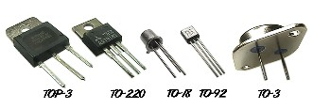
3 Bipolar Junction Transistors (BJTs)
The transistor is our most important example of an "active" component, a device that can amplify, producing an output signal with more power in it than the input signal. The additional power comes from an external source of power (the power supply, to be exact.)
The transistor is the essential ingredient of every electronic circuit, from the simplest amplifier or oscillator to the most elaborate digital computer. Integrated circuits which have largely replaced circuits constructed from discrete transistors, are themselves merely arrays of transistors and other components built from a single chip of semiconductor material.
A good understanding of transistors is very important, even if most of your circuits are made from because you need to understand the input and output properties of the IC in order to connect it to the rest of your circuit.
Finally, there are frequent (some might say too frequent) situations where the right IC just doesn't exist, and you have to rely on discrete transistor circuitry to do the job.
**Excerpts taken from: The Art of Electronics by Paul Horowitz

Slide 5
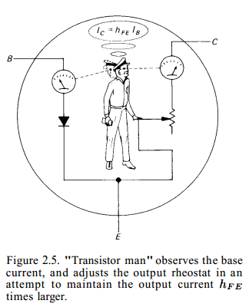
3.1 Bipolar Junction Transistors (BJTs)
A BJT transistor is a 3-terminal device available in 2 flavors (npn and pnp), with properties that meet the following rules for npn transistors (simply reverse all polarities pnp):
The collector must be more positive than the emitter.
The base-emitter and base-collector circuits behave like diodes. Normally the base-emitter diode is conducting and the base-collector diode is reverse-biased, the applied voltage is in the opposite direction to easy current flow.
Any given transistor has maximum values of I_{C}, I_{B} and V_{CE} that cannot be exceeded without costing the exceeder the price of a new transistor. There are also other limits, such as power dissipation (I_{C}V_{CE} ), temperature, V_{BE} etc., that you must keep in mind.
When rules 1-3 are obeyed, I_{C} is roughly proportional to I_{B} and can be written as I_{C} = h_{FE}I_{B} = ßI_{B} where h_{FE} the current gain (also called beta), is typically about 100.
Property 4 gives the transistor its usefulness: A small current flowing into the base controls a much larger current flowing into the collector.
**Excerpts taken from: The Art of Electronics by Paul Horowitz

Slide 6
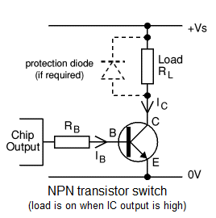
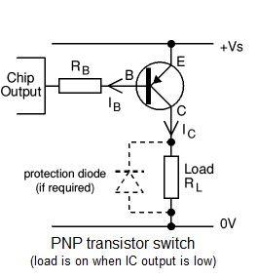
3.2 Basic Transistor Switch
This application, in which a small control current enables a much larger current to flow in another circuit, is called a transistor switch. From the preceding rules it is easy to understand. When the mechanical switch is open, there is no base current. So, from rule 4, there is no collector current. The lamp is off.
When the switch is closed, the base rises to 0.6 volt (base-emitter diode is in forward conduction). The drop across the base resistor is 9.4 volts, so the base current is 9.4mA
Overdriving the base (we used 9.4mA when 1mA would have sufficed) makes the circuit go into Saturation.
**Excerpts taken from: The Art of Electronics by Paul Horowitz

Slide 7
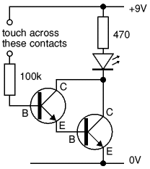
3.3 Darlington Pair Transistor Switch
The Darlington pair is a compound structure consisting of two bipolar transistors (either integrated or separated devices) connected in such a way that the current amplified by the first transistor is amplified further by the second one.
This configuration gives a much higher common-emitter current gain than each transistor taken separately and, in the case of integrated devices, can take less space than two individual transistors because they can use a shared collector. Integrated Darlington pairs come packaged singly in transistor-like packages or as an array of devices (usually eight) in an integrated circuit.
**Excerpts taken from: Wikipedia

Slide 8
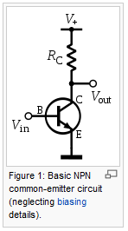
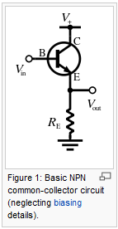
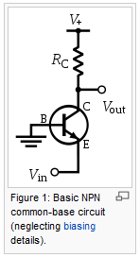
3.4 Basic BJT Amplifier Types
Common Emitter: A common-emitter amplifier is one of three basic single-stage bipolar-junction-transistor (BJT) amplifier topologies, typically used as a voltage amplifier. In this circuit the base terminal of the transistor serves as the input, the collector is the output.
Common Collector: A common-collector amplifier (also known as an emitter follower or BJT voltage follower) is typically used as a voltage buffer. In this circuit the base terminal of the transistor serves as the input, the emitter is the output.
Common Base: A common-base (also known as grounded-base) amplifier is typically used as a current buffer or voltage amplifier. In this circuit the emitter terminal of the transistor serves as the input, the collector the output.
**Excerpts taken from: Wikipedia

Slide 9
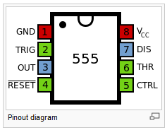
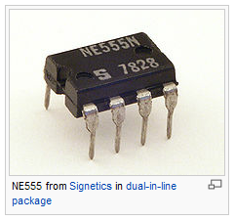
4 555 Timer
The 555 timer IC is an integrated circuit (chip) used in a variety of timer, pulse generation, and oscillator applications. The 555 can be used to provide time delays, as an oscillator, and as a flip-flop element. Derivatives provide up to four timing circuits in one package.
The 555 has three operating modes:
Monostable: in this mode, the 555 functions as a "one-shot" pulse generator. Applications include timers, missing pulse detection, bouncefree switches, touch switches, frequency divider, capacitance measurement, pulse-width modulation (PWM) and so on.
Astable: free running mode: the 555 can operate as an oscillator. Uses include LED and lamp flashers, pulse generation, logic clocks, tone generation, security alarms, pulse position modulation and so on. Selecting a thermistor as timing resistor allows the use of the 555 in a temperature sensor: the period of the output pulse is determined by the temperature. The use of a microprocessor based circuit can then convert the pulse period to temperature, linearize it and even provide calibration means.
Bistable: Schmitt trigger: the 555 can operate as a flip-flop, if the DIS pin is not connected and no capacitor is used. Uses include bounce-free latched switches.
**Excerpts taken from: Wikipedia

Slide 10
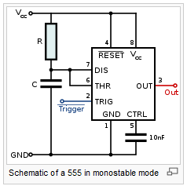
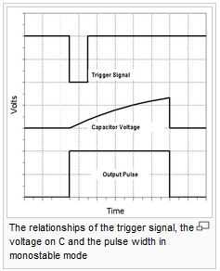
4.1 555 Timer: Monostable mode
In the monostable mode, the 555 timer acts as a "one-shot" pulse generator. The pulse begins when the 555 timer receives a signal at the trigger input that falls below a third of the voltage supply. The width of the output pulse is determined by the time constant of an RC network, which consists of a capacitor (C) and a resistor (R). The output pulse ends when the voltage on the capacitor equals 2/3 of the supply voltage. The output pulse width can be lengthened or shortened to the need of the specific application by adjusting the values of R and C.
The output pulse width of time t, which is the time it takes to charge C to 2/3 of the supply voltage, is given by t = 1.1 * RC where t is in seconds, R is in ohms and C is in farads.
While using the timer IC in monostable mode, the main disadvantage is that the time span between the two triggering pulses must be greater than the RC time constant.
**Excerpts taken from: Wikipedia

Slide 11
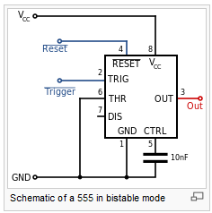
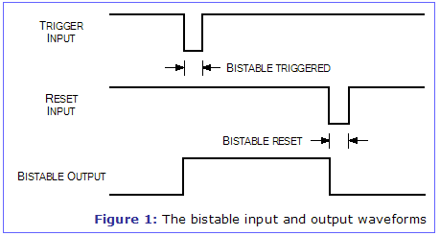
4.2 555 Timer: Bistable mode
In bistable mode, the 555 timer acts as a basic flip-flop. The trigger and reset inputs (pins 2 and 4 respectively on a 555) are held high via Pull-up resistors while the threshold input (pin 6) is simply grounded. Thus configured, pulling the trigger momentarily to ground acts as a 'set' and transitions the output pin (pin 3) to Vcc (high state). Pulling the reset input to ground acts as a 'reset' and transitions the output pin to ground (low state). Pin 5 (control) is connected to ground via a small-value capacitor (usually 0.01 to 0.1 uF); pin 7 (discharge) is left floating.
**Excerpts taken from: Wikipedia

Slide 12
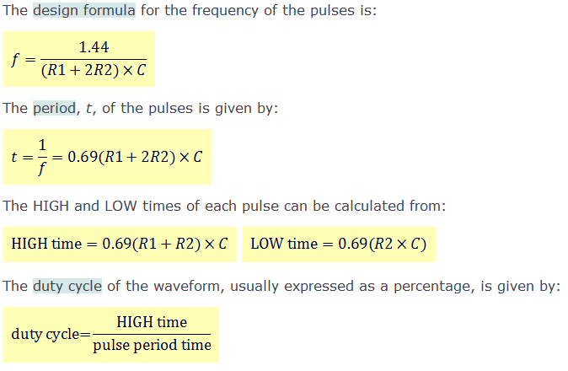
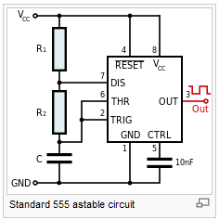
4.3 555 Timer: Astable mode
In astable mode, the 555 timer puts out a continuous stream of rectangular pulses having a specified frequency (Oscillator). Resistor R1 is connected between VCC and the discharge pin (pin 7) and another resistor (R2) is connected between the discharge pin (pin 7), and the trigger (pin 2) and threshold (pin 6) pins that share a common node. Hence the capacitor is charged through R1 and R2, and discharged only through R2, since pin 7 has low impedance to ground during output low intervals of the cycle, therefore discharging the capacitor.
**Excerpts taken from: Wikipedia

Slide 13
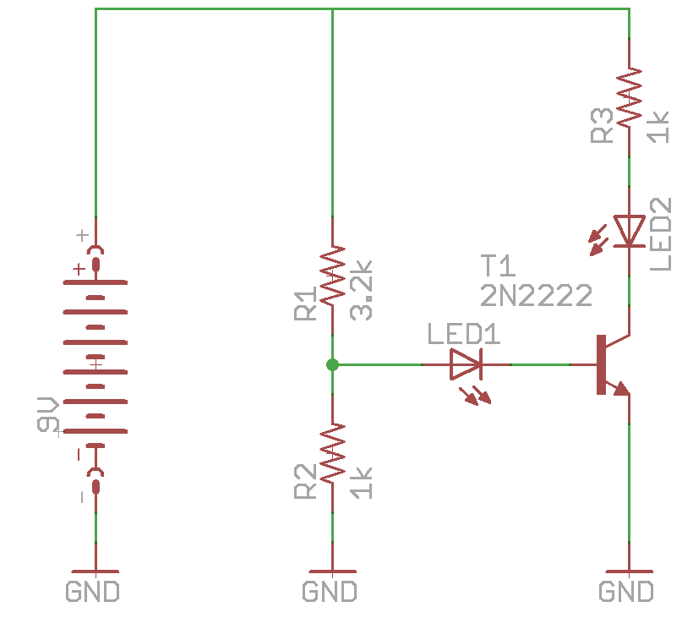
5 Lab1: Simple Transistor Amplifier
-

Slide 14
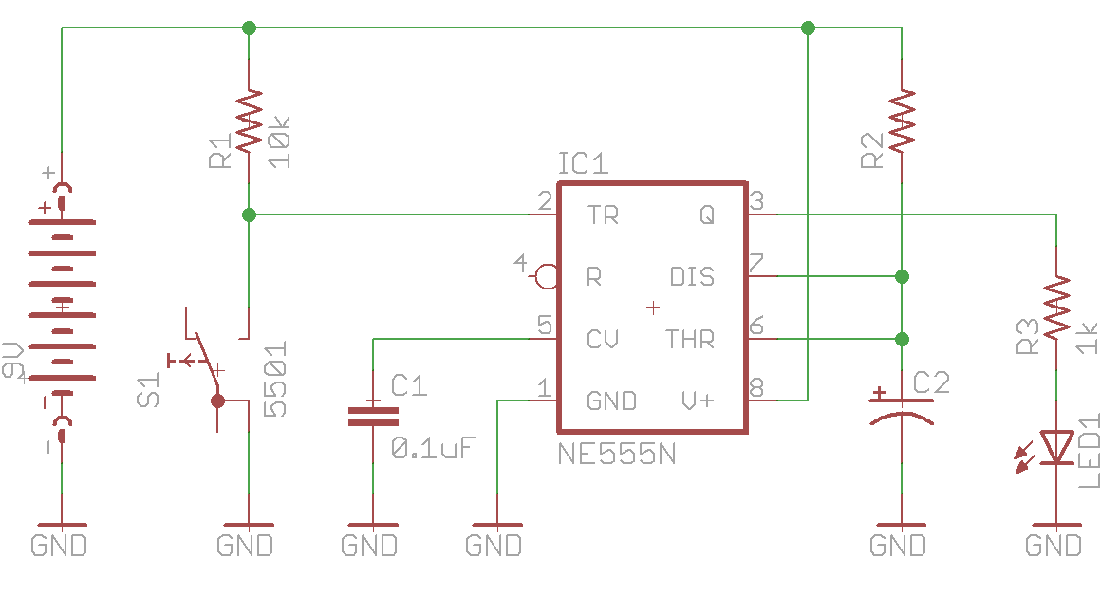
6 Lab2: 555 One Shot (Monostable)
Period (t) = 1.1 * RC (R is in Ohms, C is in Farads)
At first, try with R2= 1kOhms, C2=1uF. How long is the period?
Adjust your circuit for an approx 5seconds period.

Slide 15
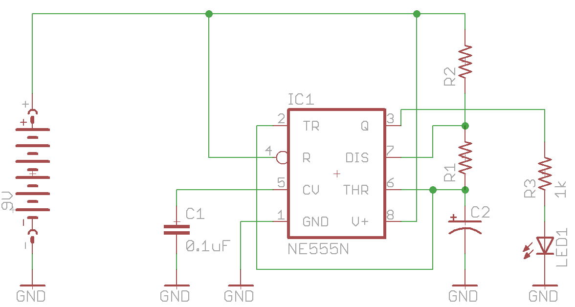
7 Lab3: 555 LED Flasher (Astable)
Period (t) = 1.1 * (R₁+R₂)C (R is in Ohms, C is in Farads)
Frequency (f) = 1/t
At first, try with R1= 1kOhms, R2=1kOhms, C2=1uF. How long is the period? What is the frequency?
Adjust C1 for a frequency of about 1Hz

Slide 16
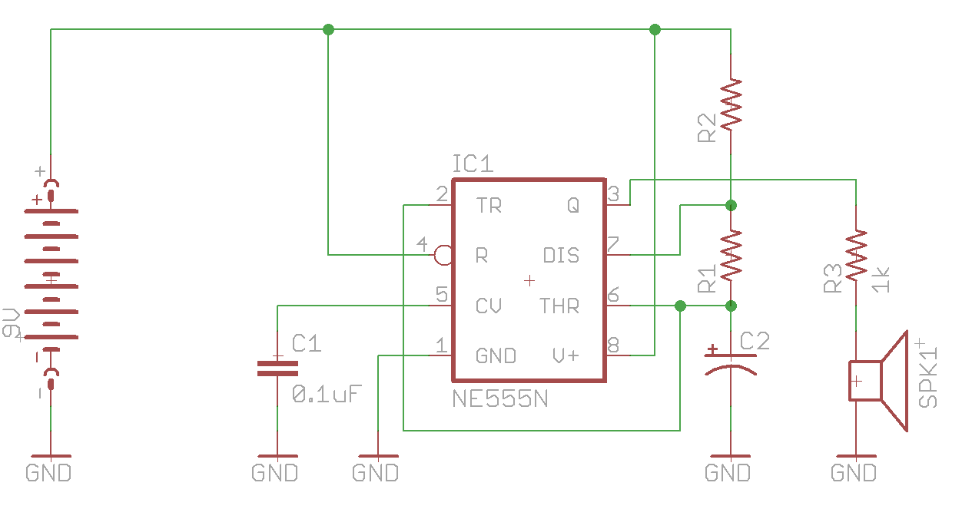
8 Lab4: 555 Buzzer
Period (t) = 1.1 * (R₁+R₂)C (R is in Ohms, C is in Farads)
Frequency (f) = 1/t
At first, try with R1=100Ohms, R2=100Ohms, C2=1nF. How long is the period? What is the frequency?
Adjust R1, R2, C1 for a frequency of about 10KHz

Slide 17
9 Final Project: Variable Supply 3v~5v
PreRequisites:
Install the free version of EagleCAD ( http://www.cadsoftusa.com/download-eagle/?language=en )
Try to familiarize yourself with EagleCAD as much as possible. Some tutorials:
https://www.sparkfun.com/tutorials/108
http://www.ianstedman.co.uk/Technical/Starting_with_EagleCAD/starting_with_eaglecad.html
Project:
Use schematic provided with the LM317 datasheet, on the first page. Feel free to use that as your design, or basis for your design.
You could also add improvements, like adding an LED and switch for ON/OFF.
You will need to prototype your design on a breadboard, and show it's working.
Once you have a working prototype, you can put your design's schematic in EagleCAD, and create a PCB (Printed Circuit Board Layout) for it.
Workshop 105 will be dedicated to EagleCAD circuit and PCB layout making.
During workshop 106, if you have a layout ready, we will go ahead and etch our own PCB, then drill them and populate the components. You will have made your own portable, variable power supply.
If by workshop 106 you don't have a PCB layout ready, I will make some of my proto boards available so that you can still build your designed power supply.

